Slide 1

AASD 4016
Full Stack Data Science Systems
Applied AI Solutions Developer Program

Slide 2
Module 6
ML Canvas
Vejey Gandyer

Slide 3
Agenda
ML Canvas
Why
Steps
Examples

Slide 4
ML Canvas

Slide 5
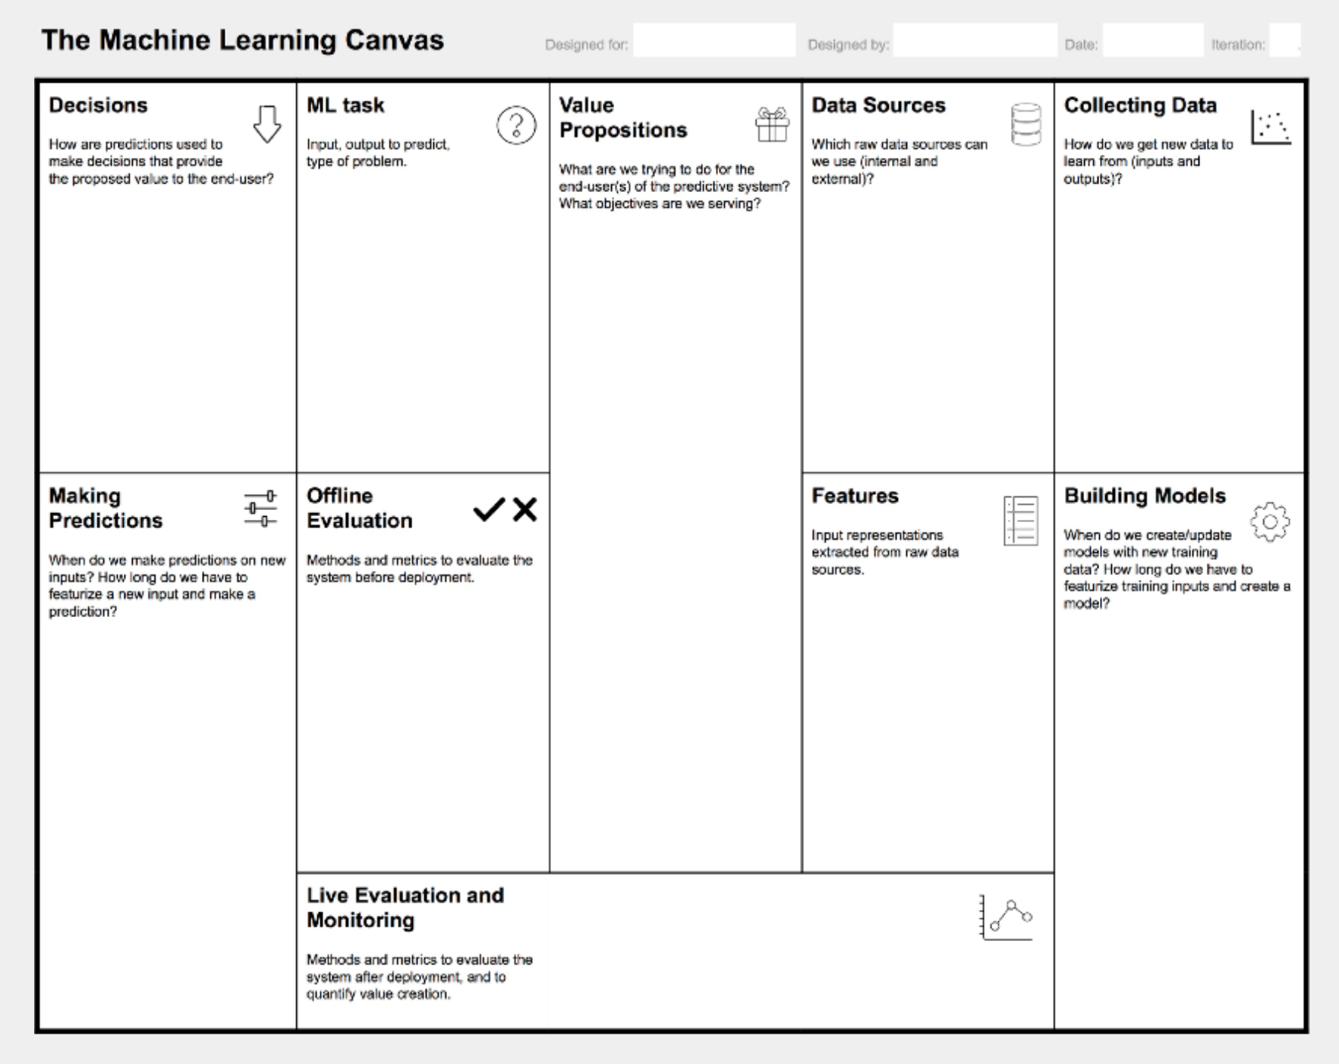

Slide 6
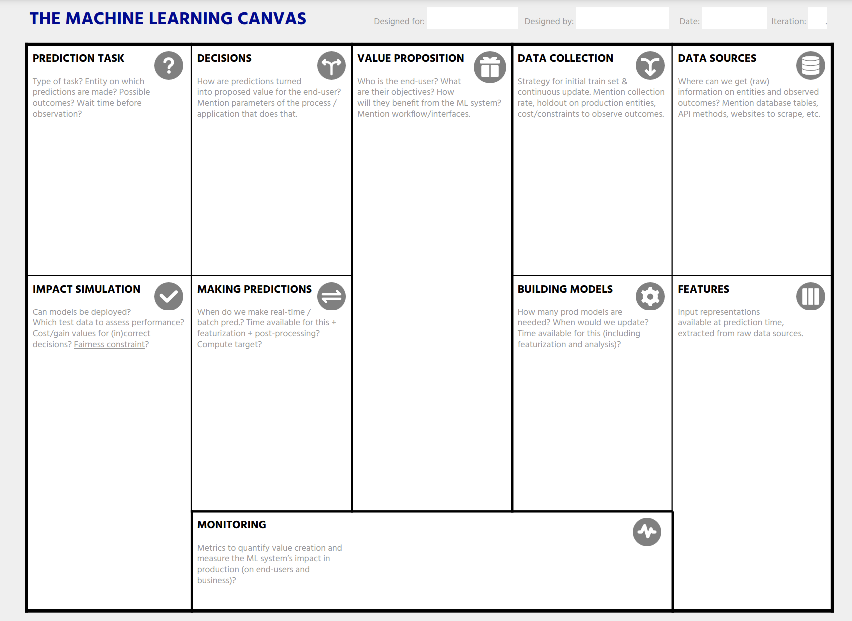

Slide 7
ML Canvas
Learn
Predict
Evaluate

Slide 8
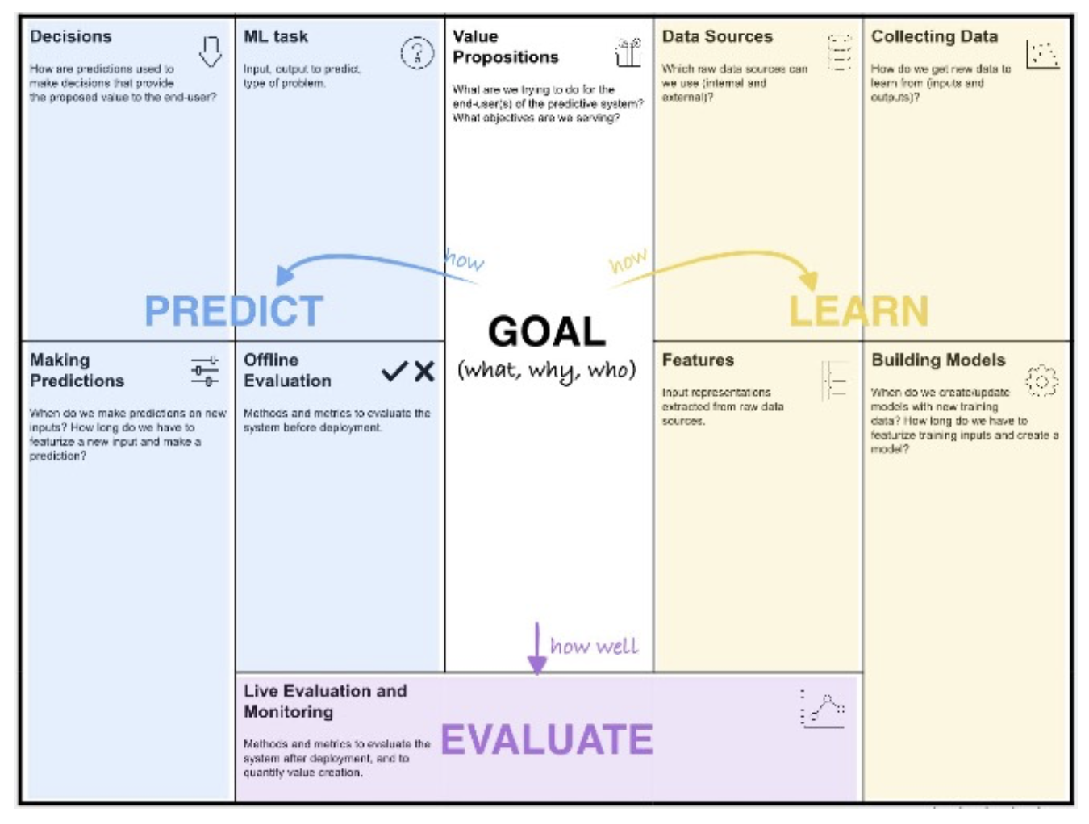

Slide 10
Further Reading
ML Canvas
https://www.ownml.co/machine-learning-canvas

